Slide 1


Slide 2


Slide 3
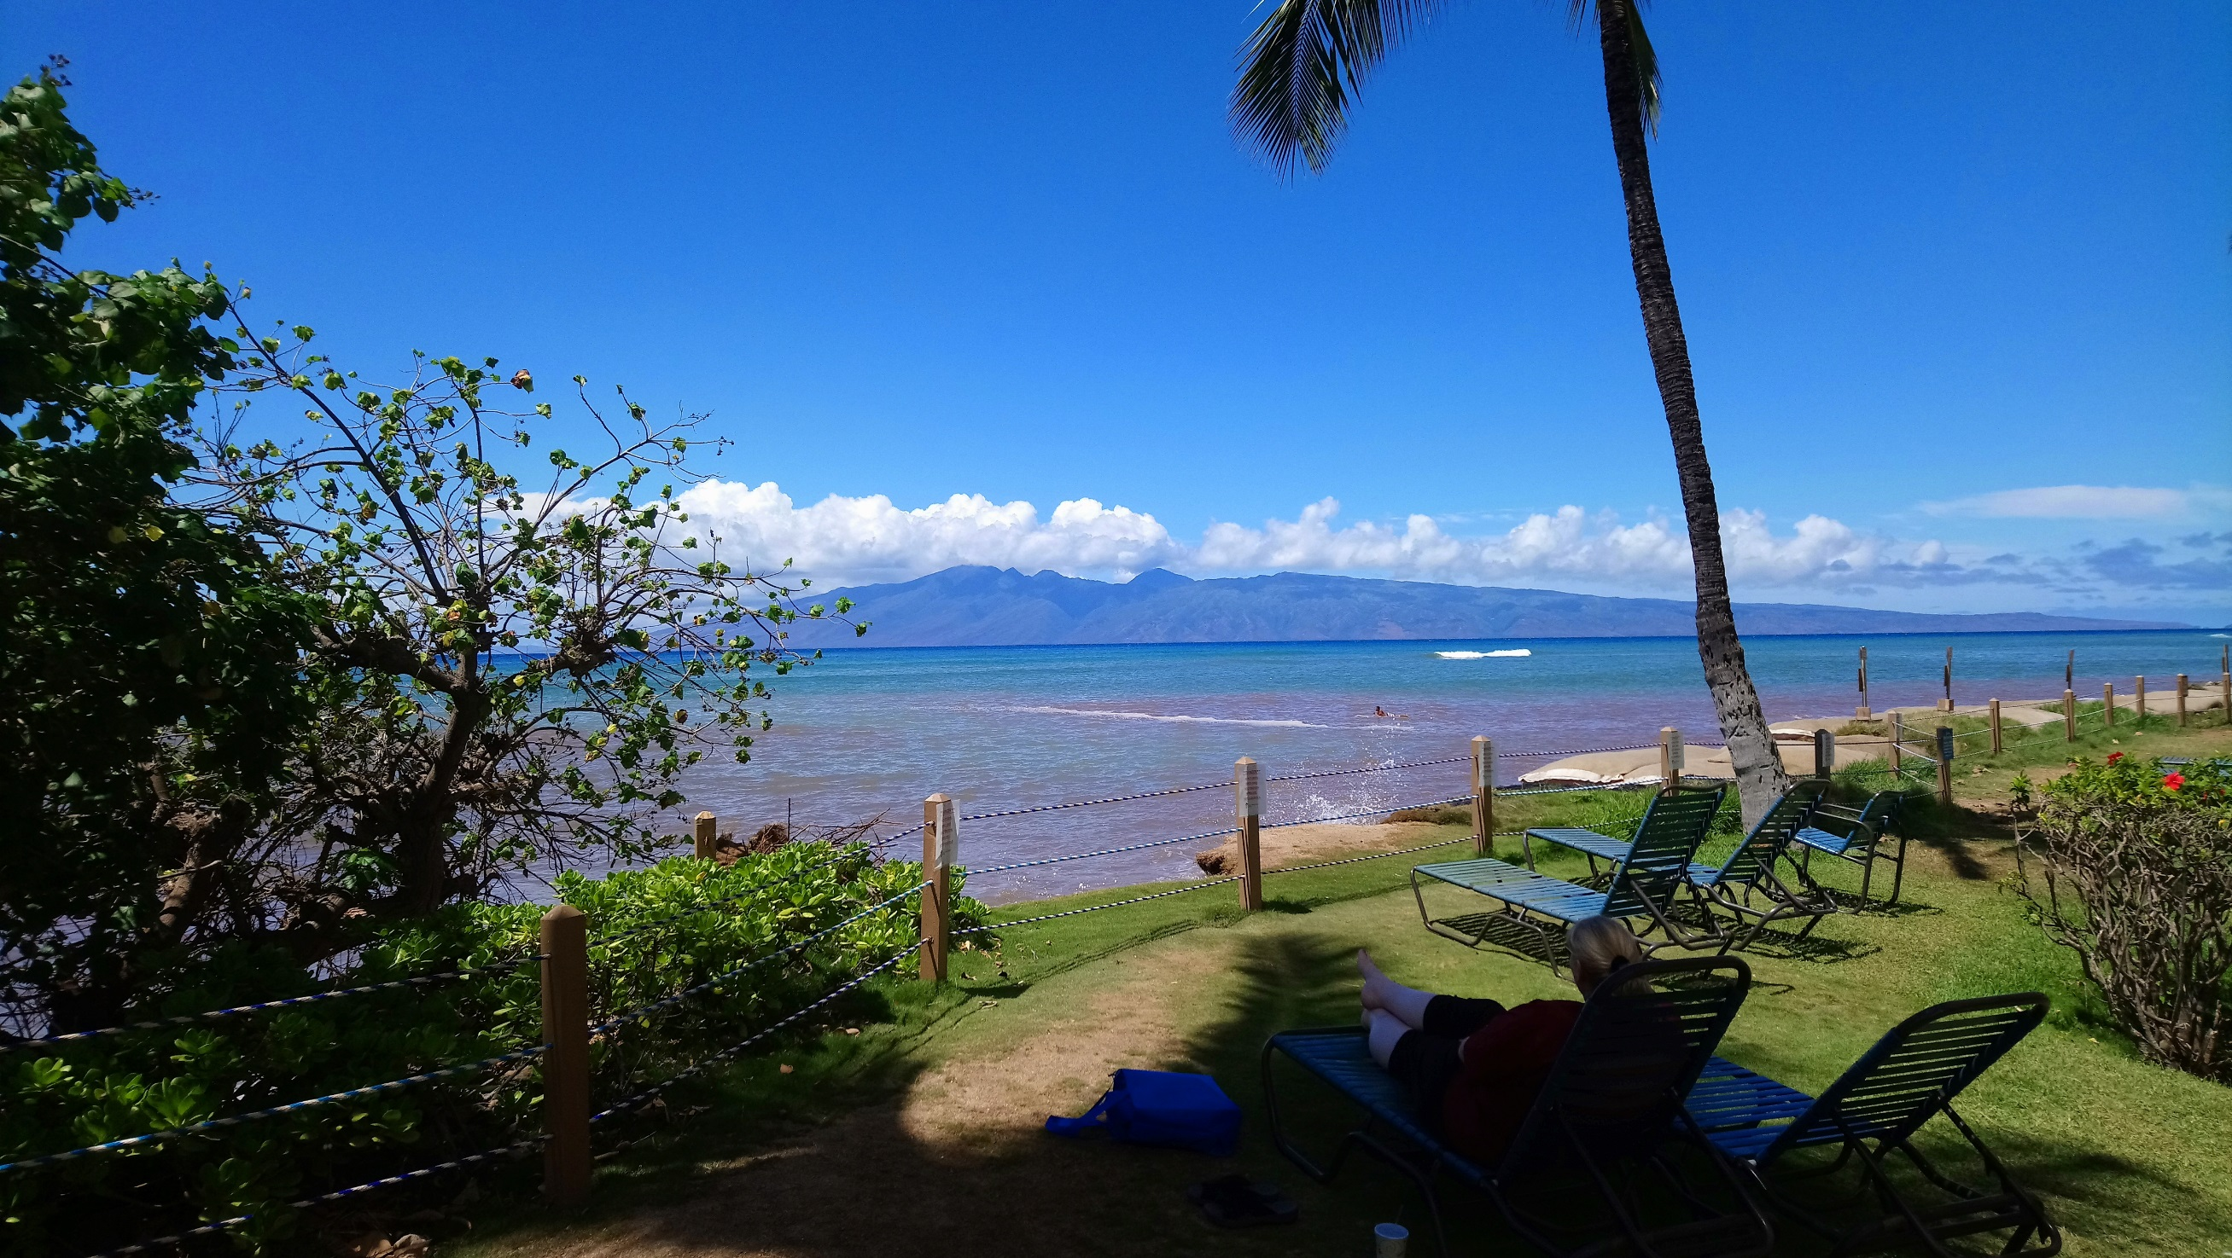

Slide 4


Slide 5


Slide 6
Closing Games and Prizes
Tim Bird
Core Embedded Linux Project
Linux Foundation

Slide 7
Thanks are due…
Thanks to everyone who makes this event possible:
Sponsors

Slide 8
Diamond Sponsor

Slide 9
Platinum Sponsors

Slide 10

Gold Sponsors

Slide 11




Silver Sponsors

Slide 12
Thanks are due…
Thanks to everyone who makes this event possible:
Sponsors
Program committee
Speakers
Attendees
Linux Foundation Event Staff

Slide 13
Some Housekeeping
Presentation page is available:
https://elinux.org/ELCE_2019_Presentations
Speakers – please submit slides to CFP site
Don’t make us hunt you down!
We made video recordings of ELC sessions
We’ll announce when those are available

Slide 14
Future events
Embedded Linux Conference 2020
June 22-24
Austin, Texas
Embedded Linux Conference Europe 2020
October 26-28
Dublin, Ireland

Slide 15
We’re going to play some games
I like games where everyone has a chance to win
Types:
Skill
Luck
Basic outline:
We narrow the contestants down
The winners come up and draw for prizes

Slide 16
What is at stake?
Prizes
Development boards
Other stuff

Slide 17
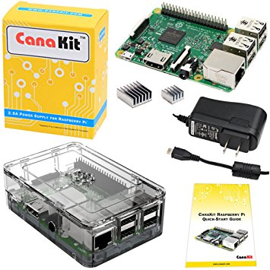
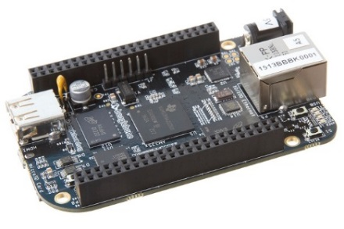
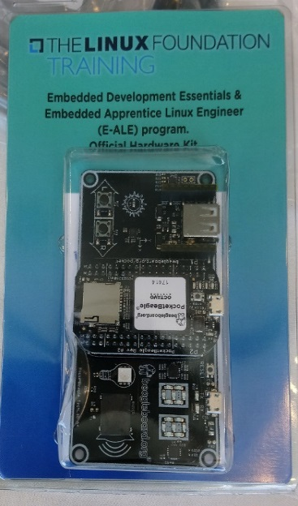
Development boards!
Raspberry Pi 3 Cana Starter kits (x2)
BeagleBone Black (x2)
Embedded Apprentice
Linux Engineer
official Hardware kit
(PocketBeagle + Techlab)

Slide 18
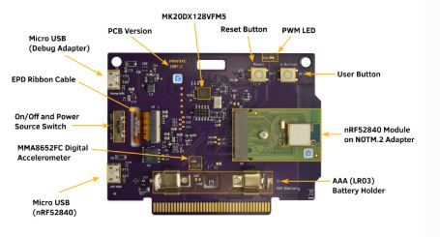
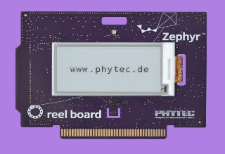
More boards
Phytec Reelboard, with 2 expansion boards (x4)
E-ink display, sensors ,Bluetooth, Ethernet
Specially designed for Zephyr projects

Slide 19
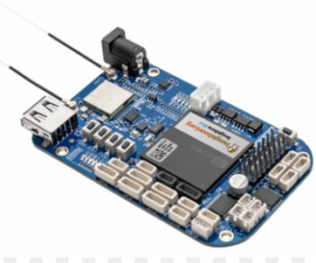
More boards
Beaglebone AI (x2)
Beaglebone Blue (x2) (robotics)
PocketBeable, with Techlab add-on board (x2)
All donated by BeagleBoard.org Foundation

Slide 20
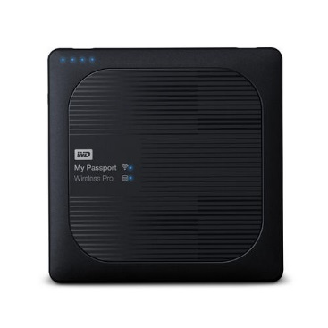
Good Stuff!
SONOS home sound system
Donated by Nutanix
Western Digital Passport Pro wireless 4TB hard disk and media server
Yocto swag
Donated by Yocto Project

Slide 21
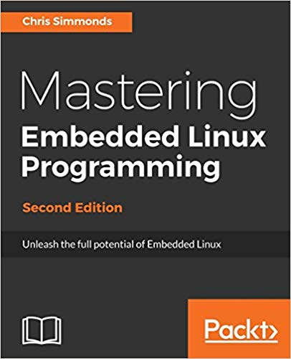

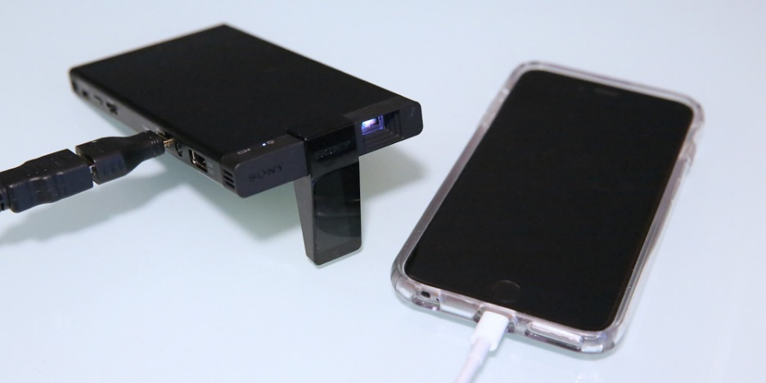
More Good stuff:
Books (x4):
Mastering Embedded Linux
Programming, by Chris Simmonds
LWN.net subscriptions (x2)
Sony MP-CD1 mobile projector
*phone not included

Slide 22
Our First Game
Technical and Nerd Trivia

Slide 23
Our First Game
Technical and Nerd Trivia
Important Disclaimer: The game is NOT fair.

Slide 24
Warmup Question
What is the latest kernel version available from Linus Torvalds?
Green = v5.4-rc5
Red = v5.3

Slide 25
Answer
Green = v5.4-rc5
While 5.3 is the current “release” version of the kernel, the latest “release candidate” is available for those who want to test things out ahead of the next release.

Slide 26
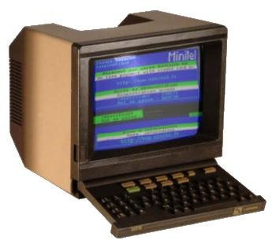
Question - 1
The Minitel service provided the residents of France access to information and the ability to purchase items beginning in the early 1980's, much like the World Wide Web does today. When was Minitel retired?
Green = Before Jan 1, 2010
Red = After Jan 1, 2010

Slide 27
Answer
Red = After 2010
France Telecom retired the service in
June 2012.
Source: https://en.wikipedia.org/wiki/Minitel

Slide 28
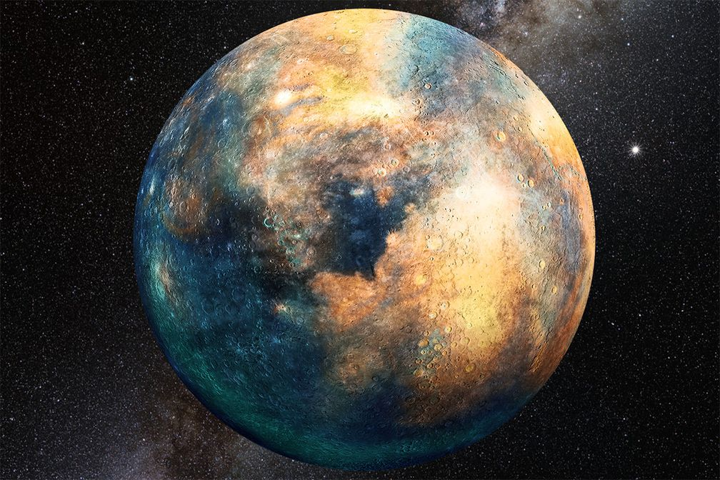
Question – 2
Linux has landed on only one other planet besides Earth.
Green = True
Red = False

Slide 29
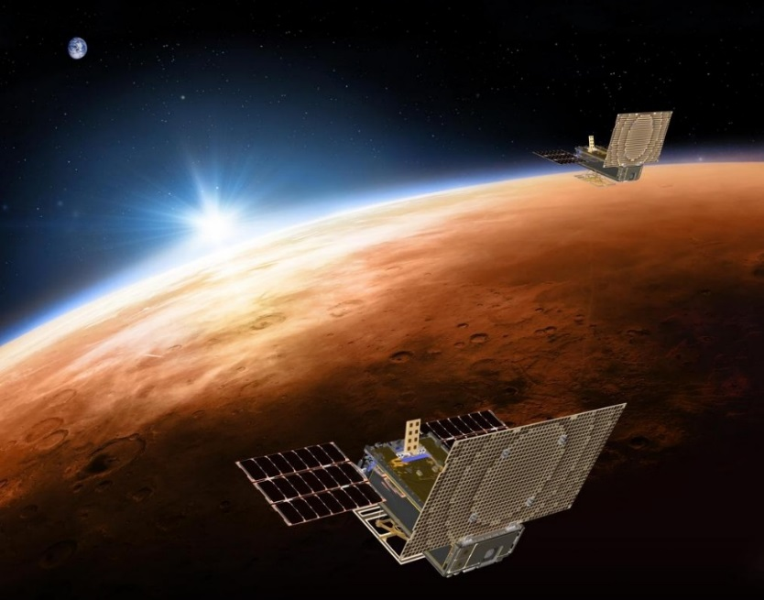
Answer
Red = False
Linux was in cube sats that went to Mars (built using Yocto Project), Nov 2018 http://linuxgizmos.com/cubesats-that-confirmed-mars-insight-landing-feature-embedded-linux-com/
But these did NOT land on the planet’s surface. No lander has used Linux yet.

Slide 30
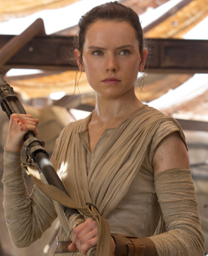
Question – 3
On which planet does Rey (from Star Wars) grow up?
Green = Tatooine
Red = Jakku
Image by Source (WP:NFCC#4), Fair use, https://en.wikipedia.org/w/index.php?curid=48866421

Slide 31
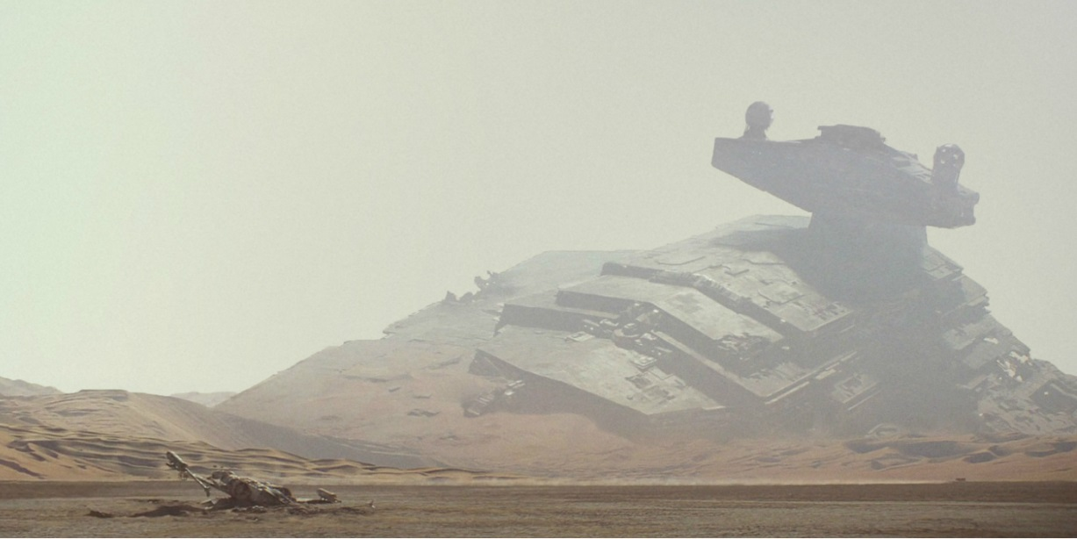
Answer
Red = Jakku
Jakku was where Rey lived at the start of Episode 7. Tatooine was where Anakin and Luke Skywalker were raised*.
*This happened a long time ago, in a galaxy far, far away.

Slide 32
Question - 4
How many files in the linux 5.4-rc5 kernel have SPDX License ID headers?
Green = about 36000
Red = about 48000

Slide 33
Answer
Red = about 48000
5.4-rc5 has 48084 files with SPDX license headers from a total of 73,200 --> 66%.
This is up from 5.1.21 which had 35% of the files.
Thanks to Thomas Gleixner and Greg KH for the cleanup work between these releases that landed in 5.2.

Slide 34
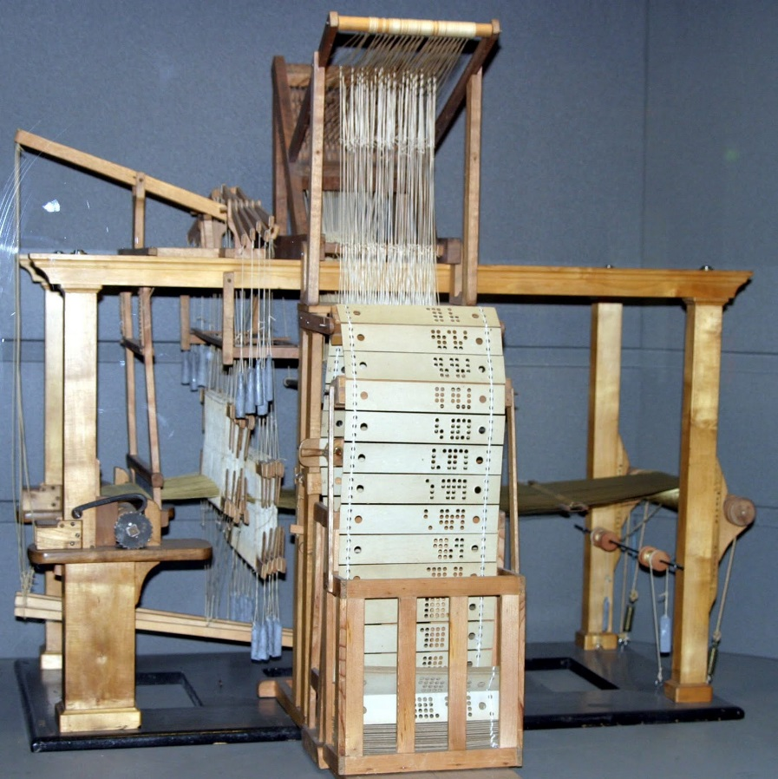
Question - 5
The very first “stored program” machine was a loom that used punched wooden cards to automatically weave fabric designs. This machine was invented in France.
Green = True
Red = False

Slide 35
Answer
Green = True
Source: https://www.livescience.com/20718-computer-history.html
The machine was invented in France in 1801 by Joseph Marie Jacquard. It was actually used here in Lyon in silk fabric production.

Slide 36
Question - 6
I am Thomas Petazzoni.
Green = True
Red = False
(hold up Green only if you are actually
Thomas Petazzoni)

Slide 37

Answer
Green = True
Thomas Petazzoni:
Involved with ELC for 11 years
Over 24 presentations and sessions
Keynote at ELC Europe 2015.
CTO of bootlin
One of the top contributors to buildroot
He leads a bunch of French people.

Slide 38
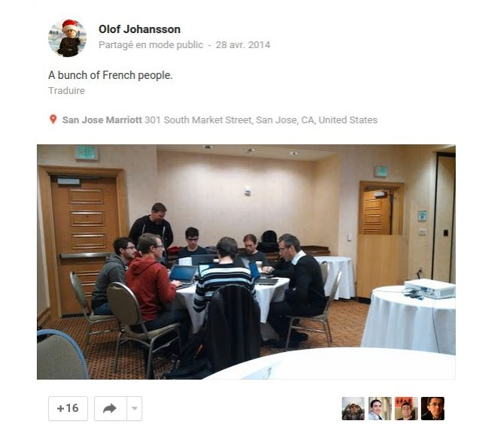
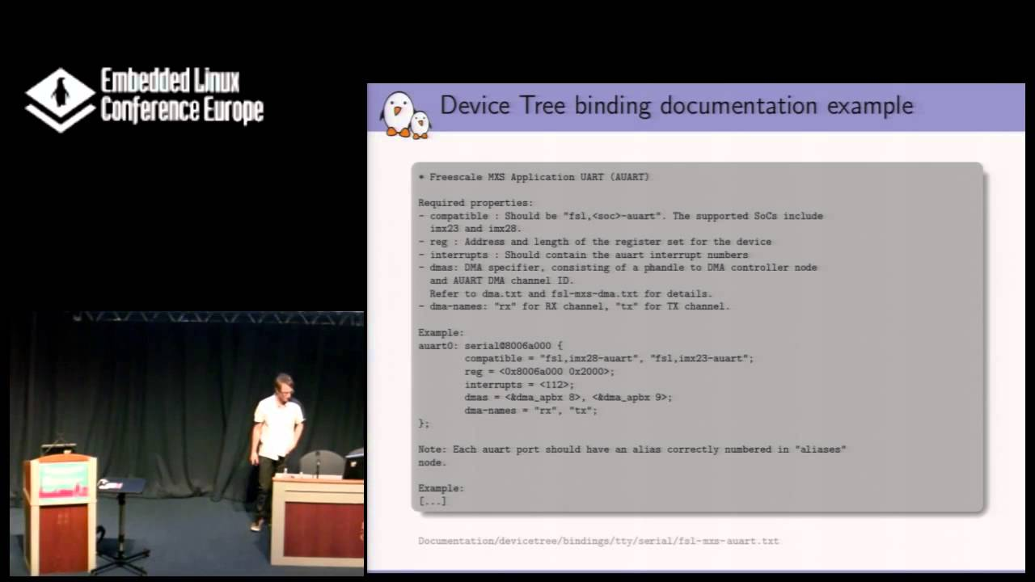
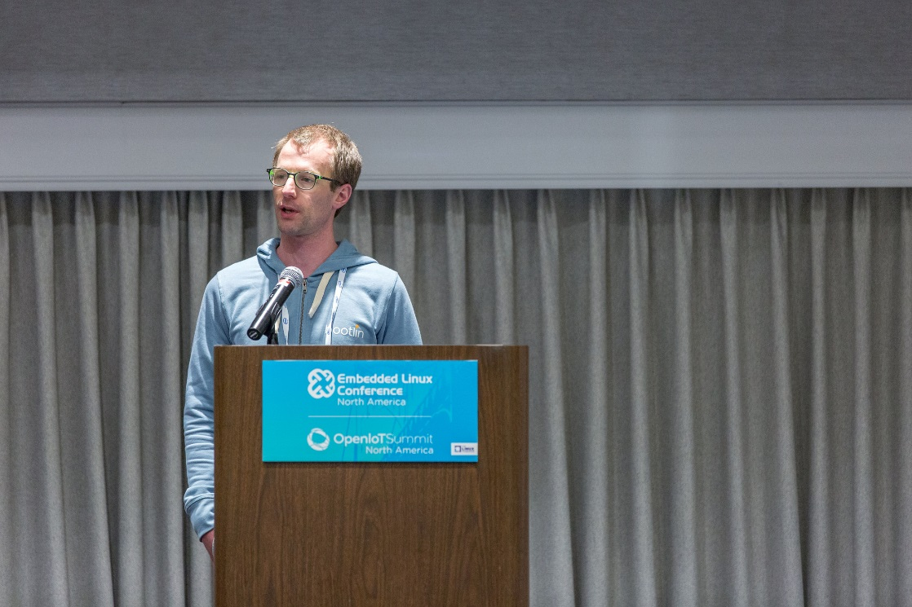
More Thomas Petazzoni

Slide 39
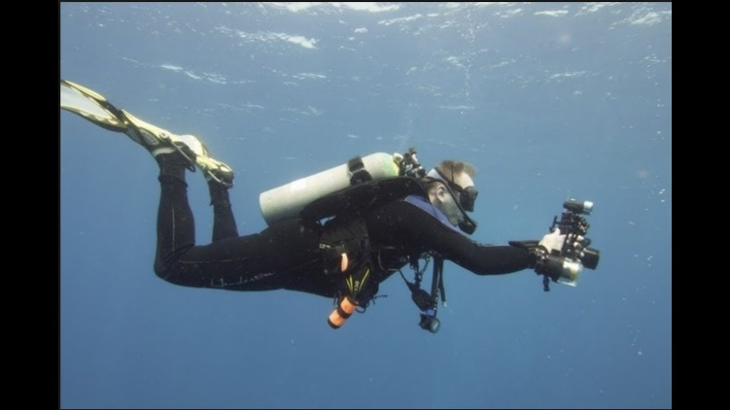

Question - 7
According to Linus Torvald, he wasn’t sure he was a good programmer until he wrote what other open source program?
Green = subsurface
Red = git

Slide 40
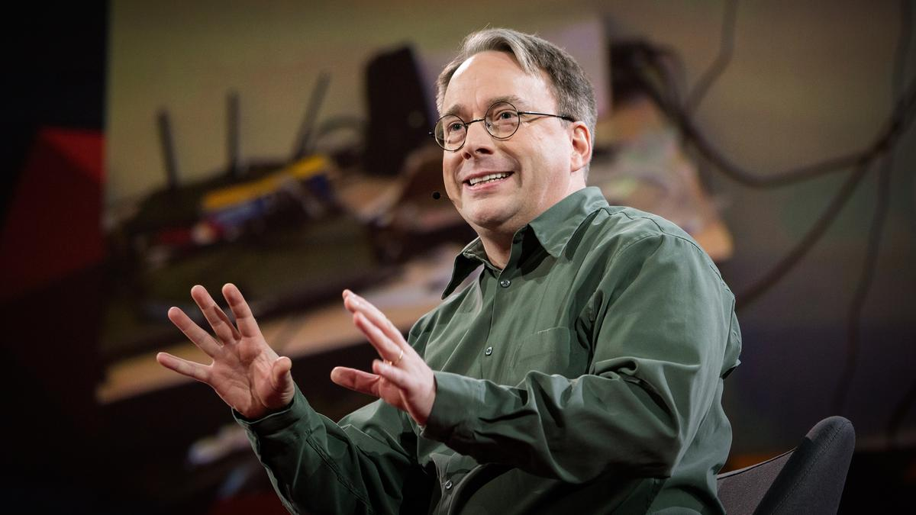
Answer
Red = git
Linus gives most of the credit for modern git to Junio Hamano, but creating it reassured him he wasn’t a “one-trick pony” with Linux.

Slide 41
Question - 8
What continent has the highest concentration of Linux users:
Green = North America
Red = Eurasia
Green & Red = None of the above

Slide 42
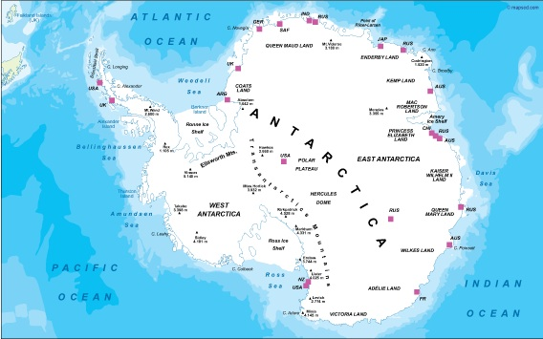
Answer
Green & Red = None of the above
The continent with the highest percentage users of Linux is Antarctica.

Slide 43
Question - 9
The first Embedded Linux Conference Europe was held in this country:
Green = The Netherlands
Red = Austria

Slide 44
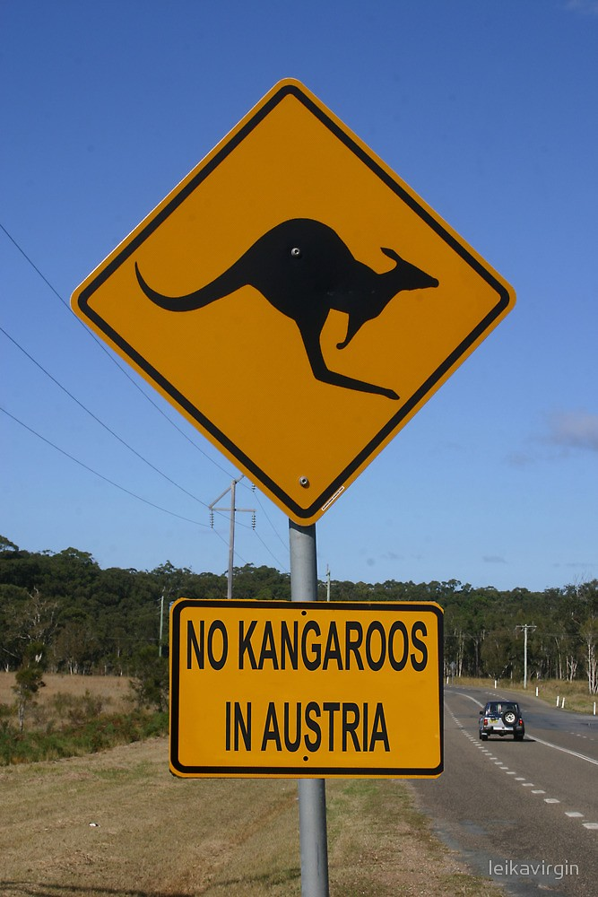
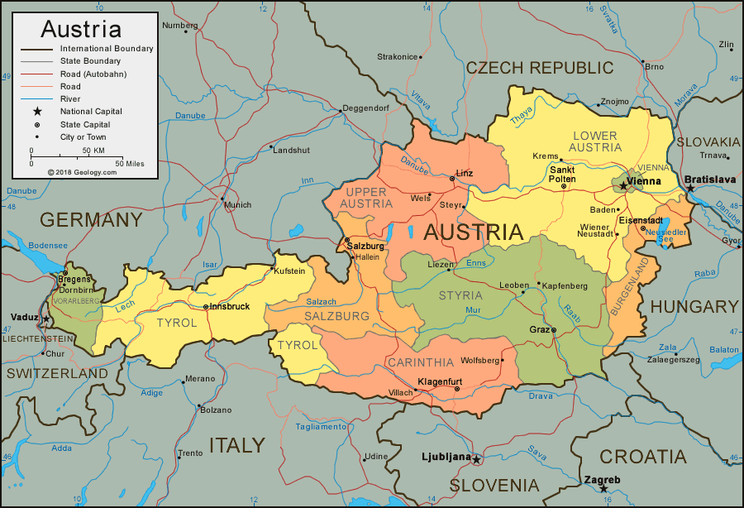
Answer
Red = Austria
The first ELC Europe
was held in
Linz, Austria.

Slide 45
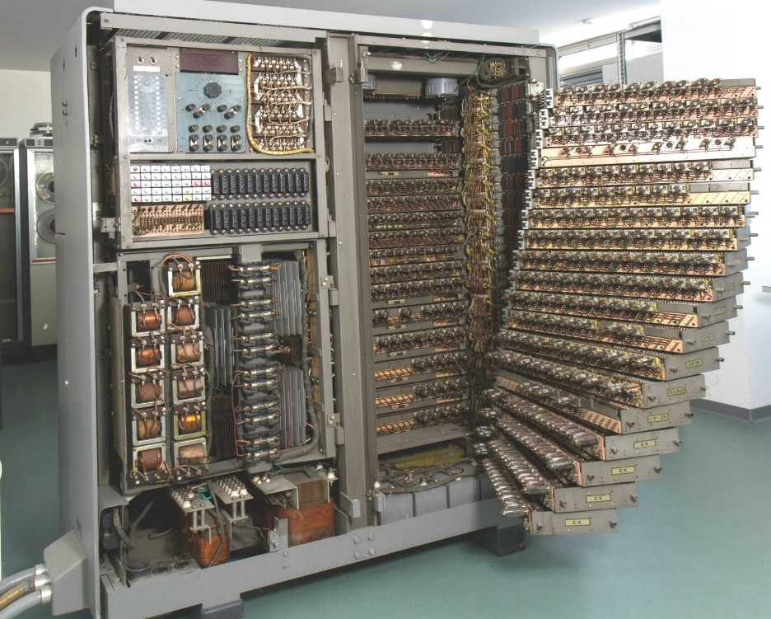
Question - 10
The first electronic computer produced in France was the Gamma 3 electronic calculator from Compagnie des Machines Bull.
What year was it produced?
Green = 1952
Red = 1957
Image CC-BY-NC 4.0 - technikum29 computer museum

Slide 46
Answer
Green = 1952
Source:
http://www.historyofinformation.com/detail.php?id=693

Slide 47
Question - 11
The GNOME Foundation recently had a patent lawsuit filed against them, by noted patent troll Rothschild Patent Imaging, LCC. Rotchschild claims the patent covers the Shotwell image management application.
Unfortunately, we will likely see more software patent litigation against Open Source software in the future and there is nothing we can do about it.
Green = True
Red = False

Slide 48
Answer
Red = False
The Gnome Foundation is fighting back, and trying to invalidate the bogus patent:
https://www.gnome.org/news/2019/10/gnome-files-defense-against-patent-troll/
You can help by donating to their defense fund:
https://secure.givelively.org/donate/gnome-foundation-inc/gnome-patent-troll-defense-fund

Slide 49
Question - 12
Linux took over the remaining spots in the top 500 supercomputers (achieving supercomputer world domination) in what year?
Green = 2015
Red = 2018

Slide 50
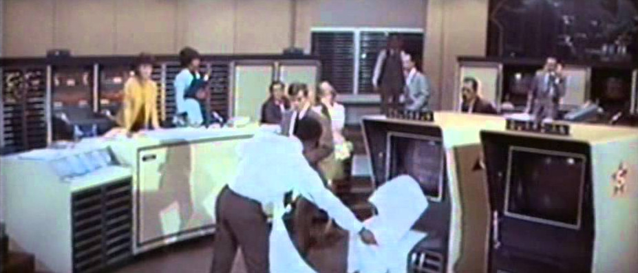
Answer
Red = 2018
Linux took over 100% of the top 500 supercomputers last year (2018)
Source: https://itsfoss.com/linux-runs-top-supercomputers/
FYI, the current leader (as of June 2019) was IBM’s Summit supercomputer (not shown here), with over 2.4 million cores and a peak performance of over 200,000 Teraflops per second.

Slide 51

Question – 13
The UK military actually has a program called “Skynet”
Green = True
Red = False

Slide 52
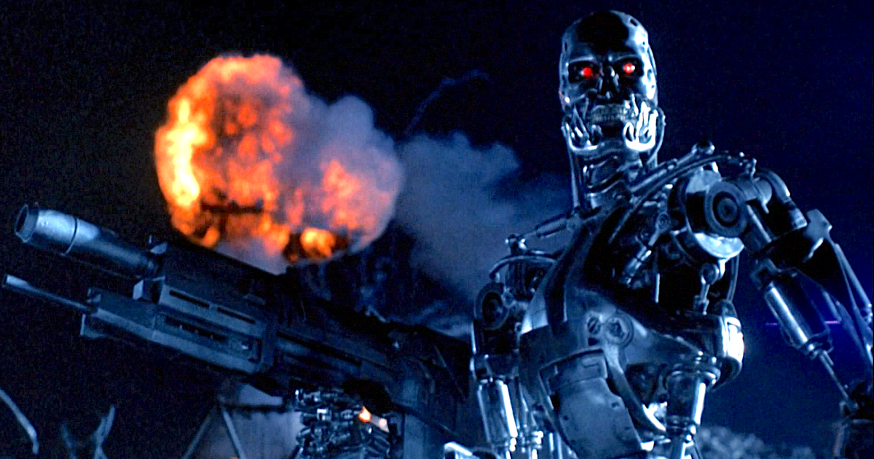
Answer
Green = True
What could
go wrong?
According to Wikipedia: Skynet is a family of military communications satellites, now operated by Airbus Defence and Space on behalf of the UK Ministry of Defence (It’s been operating since 1969, so it predates the Terminator movie series)

Slide 53
Question -14
The French Micral microcomputer was developed in 1972 as an alternative to the more expensive Digital Equipment PDP-8 minicomputer. The first Micral cost more or less than $2000?
Green = More
Red = Less

Slide 54
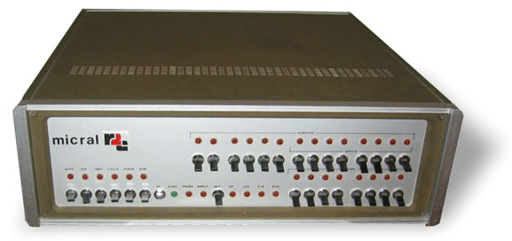
Answer
Red = Less
It was about 8500 French Francs.
Source: https://history-computer.com/ ModernComputer/Personal/Micral.html

Slide 55
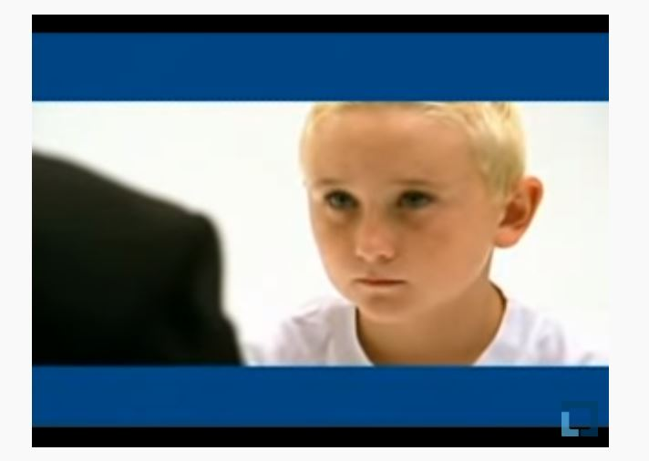
Question - 15
In the famous 2003 IBM "His Name Is Linux" TV commercial, the young blond boy who is absorbing the world's knowledge spoke only two sentences.
Green = True
Red = False

Slide 56
Answer
Red: False
The blond boy did not say a single word.
(BTW – It’s still a great commercial)
https://youtu.be/x7ozaFbqg00

Slide 57
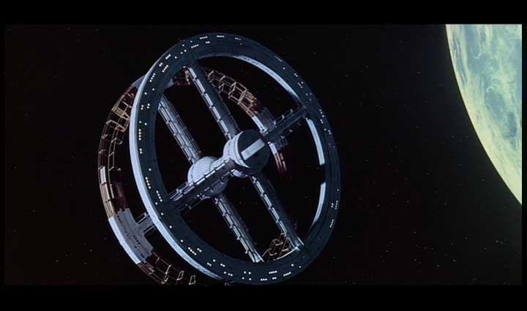
Question - 16
Bigelow Aerospace recently announced plans for a rotating space station in low earth orbit for use, in part, as a space hotel. The first elements are to be in place by 2025.
Green = True
Red = False
Note: this image is of the fictional space station from the movie “2001 A Space Odyssey”

Slide 58
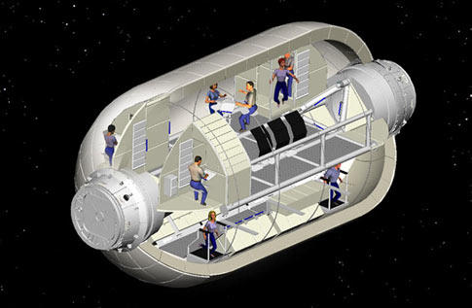
Answer
Red = False
Bigelow Aerospace makes inflatable space habitats, and has had one docked at the International Space Station for two years. But they have not announced plans for a rotating station.

Slide 59
Question - 17
What computer language is set to be retired early next year?
Green = UrduScript
Red = Python

Slide 60
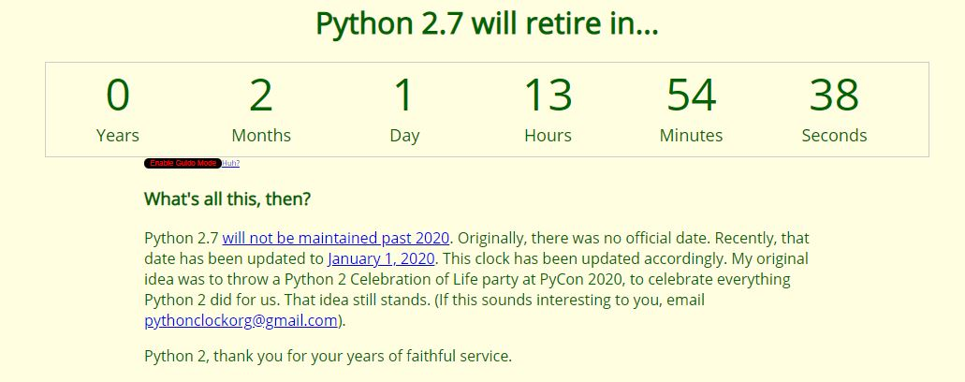
Answer
Red = Python (version 2)
Support for version 2 of the Python programming language is set to expire on Jan 1, 2020. See here for a countdown: https://pythonclock.org

Slide 61
Got to here!!

Slide 62
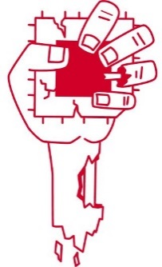

Question - 18
Which of these logos is for an exploit related to speculative execution:
Green =
Red =

Slide 63
Answer
BOTH Green and Red!
= Zombieload
= Spectre

Slide 64
Question - 19
EBCDIC and ASCII are relative newcomers. An earlier character encoding, Baudot, was invented by Frenchman Emile Baudot.
Was Baudot encoding developed before or after 1910?
Green = Before 1910
Red = After 1910

Slide 65
Answer
Green = Before 1910
Baudot was invented in 1870 for use with the telegraph.
Source: https://en.wikipedia.org/wiki/List_of_French_inventions_and_discoveries#Communication_&_Computers
Source:
https://en.wikipedia.org/wiki/Baudot_code

Slide 66
Question - 20
Microsoft has begun shipping the Linux kernel to many of their Windows customers.
Green = True
Red = False

Slide 67
Answer
Green = True
Microsoft’s Windows Subsystem for Linux (WSL) version 2 includes a “real” Linux kernel, and can be used to run Linux apps on Windows 10.
https://www.howtogeek.com/424886/windows-10s-linux-kernel-is-now-available/

Slide 68
Question - 21
A significant security exploit, in the “spectre” family, is called:
Green = Zombieland
Red = Zombieload Attack

Slide 69


Answer
Red = Zombieload Attack
≠

Slide 70
Question - 22
The Linux Foundation has become the home to many open source projects. How many are there currently?
Green = about 120
Red = about 170

Slide 71
Answer
Red = about 170
It’s hard to count, since new projects are created regularly. There are 166 projects listed here: https://www.linuxfoundation.org/projects/directory/
and I’m aware of some not listed.

Slide 72
Question - 23
“Meltdown” is the name for when your NAND flash gets corrupted due to uneven wear leveling.
Green = True
Red = False

Slide 73

Answer
Red = False
“Meltdown” refers to a class of
hardware bugs in the area of
CPU speculative execution.

Slide 74
Question - 24
The initial implementation of PCI support in the kernel used a hardcoded server name.
Green = True
Red = False

Slide 75
Answer
Green = True
The initial HP implementation was buggy, so one the first PCI implementation accepted upstream was by Fujitsu, and it used a hardcoded server name of “Primequest”.

Slide 76
Question - 25
After 13 long years out-of-tree, the PREEMPT_RT patch set is now poised to be accepted into mainline. The initial kconfig entry has already been accepted.
Green = True
Red = False

Slide 77
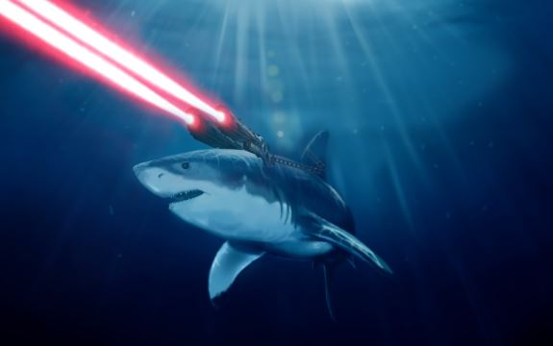
Answer
Green = True
The kconfig entry for PREEMPT_RT was added in the 5.3 kernel. See kernel/Kconfig.preempt.

Slide 78
Question - 26
The very first motion picture was produced by the Lumiere Brothers, here in Lyon.
Green = True
Red = False

Slide 79
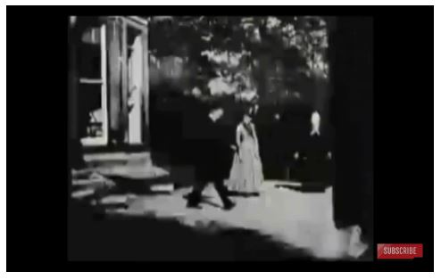
Answer
Red = False
According to the Guinness Book of Records, the earliest motion picture by a single camera was a 2 second clip made by Louis Le Prince, called “Roundhay Garden Scene” made in 1888 in Leeds, England.

Slide 80
Game 1 over Time for Game 2

Slide 81
How to play
Everyone stands
Hold up red paper or green paper for each answer
If you’re wrong, sit down
We repeat questions until only a few people remain standing
Those people get to draw for a prize
Repeat until it’s no fun anymore
ie the prizes are gone

Slide 82
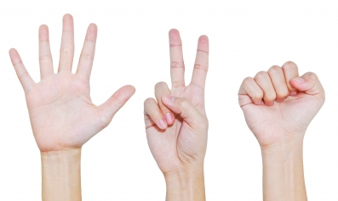
Rock, Paper and Scissors
Picture by Kittikun Atsawintarangkul

Slide 83
Our Second Game
Rock, Paper, Scissors
- against the presenter

Slide 84

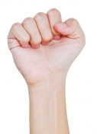
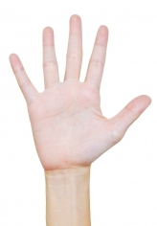
Rules
Rock beats scissors
Scissors cuts paper
Paper covers rock
If you beat the presenter you stay in the game.

Slide 85
Ready, Set,…

Slide 86
Round 1
Presenter is:
Stay in game if you are:

Slide 87
Ready, Set,…

Slide 88
Round 2
Presenter is:
Stay in game if you are:

Slide 89
Ready, Set,…

Slide 90
Round 3
Presenter is:
Stay in game if you are:

Slide 91
Ready, Set,…

Slide 92
Round 4
Presenter is:
Stay in game if you are:

Slide 93
Ready, Set,…

Slide 94
Round 5
Presenter is:
Stay in game if you are:

Slide 95
Ready, Set,…

Slide 96
Round 6
Presenter is:
Stay in game if you are:

Slide 97
Ready, Set,…

Slide 98
Round 7
Presenter is:
Stay in game if you are:

Slide 99
Ready, Set,…

Slide 100
Round 8
Presenter is:
Stay in game if you are:

Slide 101
Ready, Set,…

Slide 102
Round 9
Presenter is:
Stay in game if you are:

Slide 103
Ready, Set,…

Slide 104
Round 10
Presenter is:
Stay in game if you are:

Slide 105
Ready, Set,…

Slide 106
Round 11
Presenter is:
Stay in game if you are:

Slide 107
Ready, Set,…

Slide 108
Round 12
Presenter is:
Stay in game if you are:

Slide 109
Ready, Set,…

Slide 110
Round 13
Presenter is:
Stay in game if you are:

Slide 111
Ready, Set,…

Slide 112
Round 14
Presenter is:
Stay in game if you are:

Slide 113
Ready, Set,…

Slide 114
Round 15
Presenter is:
Stay in game if you are:

Slide 115
Ready, Set,…

Slide 116
Round 16
Presenter is:
Stay in game if you are:

Slide 117
Ready, Set,…

Slide 118
Round 17
Presenter is:
Stay in game if you are:

Slide 119
Ready, Set,…

Slide 120
Round 18
Presenter is:
Stay in game if you are:

Slide 121
Ready, Set,…

Slide 122
Round 19
Presenter is:
Stay in game if you are:

Slide 123
Ready, Set,…

Slide 124
Round 20
Presenter is:
Stay in game if you are:

Slide 125
Ready, Set,…

Slide 126
Round 21
Presenter is:
Stay in game if you are:

Slide 127
Ready, Set,…

Slide 128
Round 22
Presenter is:
Stay in game if you are:

Slide 129
Ready, Set,…

Slide 130
Round 23
Presenter is:
Stay in game if you are:

Slide 131
Ready, Set,…

Slide 132
Round 24
Presenter is:
Stay in game if you are:

Slide 133
Game 2 over Time for a closing thought...

Slide 134
Recent Events
Got some emails from Gitlab
Announcing a new telemetry policy
Apologizing and reverting the new telemetry policy
Problem was that sending usage data to a 3rd party was opt-out rather than opt-in
Bigger problem was Gitlab not discussing the new policy ahead of time with its customers and community
Linux Foundation just announced a new policy on Telemetry policies

Slide 135
Observations
People are passionate about what they do
And passionate about their data, privacy, etc.
The Gitlab CEO apologized
Calls for firing a Gitlab officer over comments made on a discussion board

Slide 136
Observations
People are passionate about what they do
And passionate about their data, privacy, etc.
The Gitlab CEO apologized
Calls for firing a Gitlab officer over comments made on a discussion board
This seems to me to be an over-reaction

Slide 137
Kindness
Apologizing puts someone in a position of relative weakness
I think it’s important not to abuse that and push for more than appropriate remedies
Admonition for kindness is only partly about improving the situation for the target of the kindness

Slide 138

Making things better
Open Source attracts some people as a way to contribute to the greater good in the world.
Be kind while doing it – you’ll make other’s and your own life better in the process.

Slide 139
Thanks for coming
Hope you learned something new, and had a good time.
See you next year!

Slide 140
Thanks for being here!

Slide 141
Development boards!
Embedded Apprentice
Linux Engineer
official Hardware kit
(PocketBeagle + Techlab)

